Slide 1
Quantopian project
Diego Fernando Chacón

Slide 2
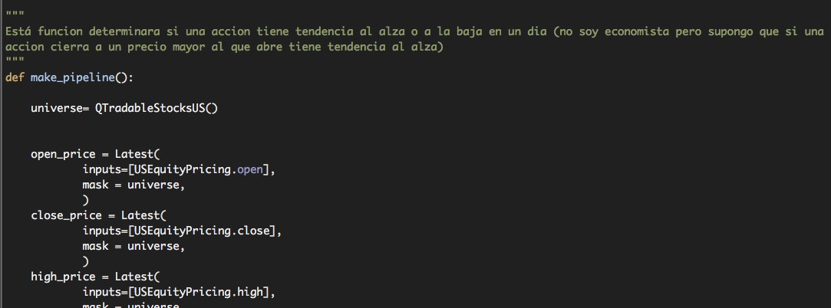
Corazón del éxito

Slide 3

Constrains

Slide 4
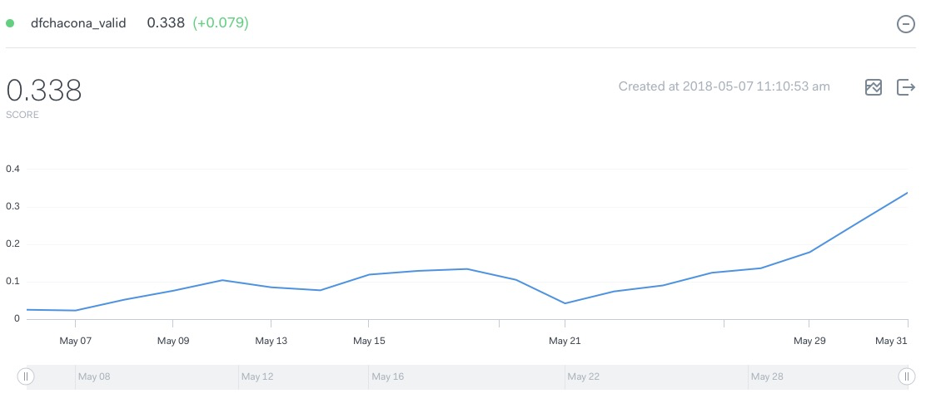

Contest

Slide 5
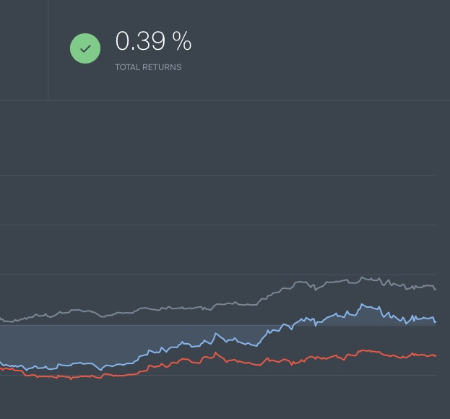
Backtest

